Slide 1

ML Bootcamp Project – NBA Predictor
Is it possible to use machine learning models to predict a teams points total for a game and is it accurate enough to win money over the course of a season?
Daniel Jonathan Walker

Slide 2
Hypothesis
This project is to determine whether if using different regression models with different parameters, by configuring new and different features, we are able to predict a teams points score being over or under the bookies prediction.
Then by simulating each game using the real results, we can analyse if enough predictions were successfully made to gain a return on the original investment.
1.83 Odds
Bookies Prediction = 110 points
1.83 Odds

Slide 3



Index
1. Workflow
2. Dataset – Data Wrangling
3. Features - Heat Map
4. Conclusive vs Non Conclusive Predictions
5. Results
6. Conclusion

Slide 4

Workflow
Oddsportal.com
Masseyratings.com
Tableau / PowerBi
Web Scraping
Results
Bookie Data
Data Wrangling
Unify Formats
Add columns
Streamlit
Data Wrangling
Join Data
Unify Formats + Drop Duplicates
Add Columns
Machine Learning
Train
Fit
Predict
Flask
MySQL
Clean Data
Model Results
Drive
.jpg
.csv

Slide 5

Dataset & Data Wrangling
1080 games (x2 as both teams predicted individually)
26 removed as there was no bookie prediction
Columns Available To Train Model
Team
Opponent
Home or Away
Predicted Team Score
Predicted Total Score
Odds To Win
Win % Prediction
Columns Added/Modified To Train Model
Final Score --→ Avg Score
Difference From Previous Predictions
Opponent Score --→ Avg Score
Opponent Difference From Predictions
Opponent Avg Received
Opponent Avg From Predictions
Opponent Form (Over or Under)

Slide 6
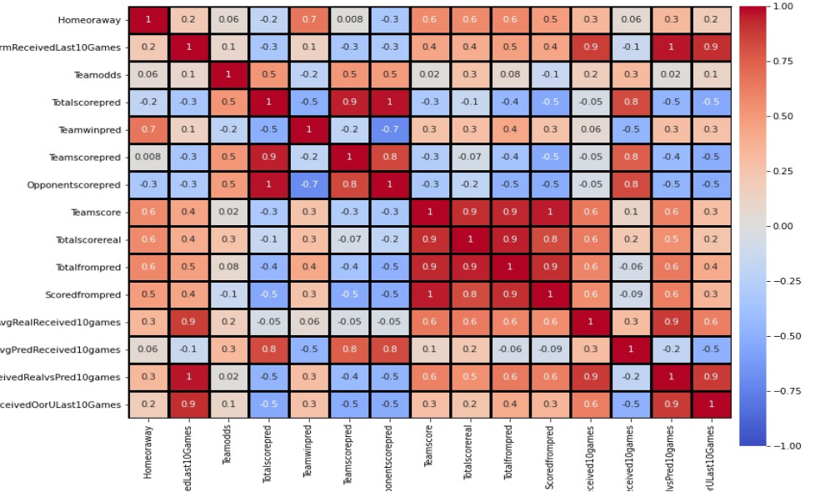
Features - Heat Map
Available
Added
Or
Modified

Slide 7
Click To Go To Streamlit For Game Prediction Format

Slide 8
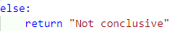
Conclusive vs Non Conclusive Predictions
Conclusive Prediction
Non Conclusive Prediction

Slide 9

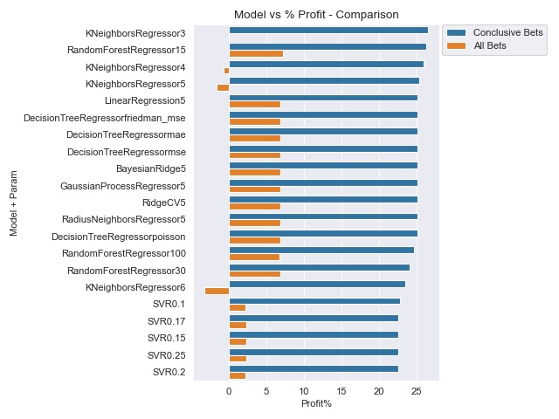
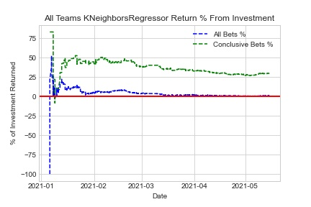
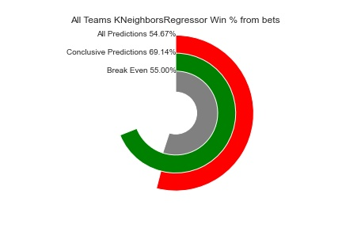
Model Results

Slide 10

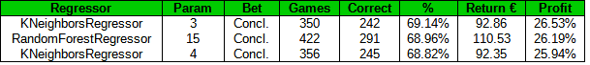
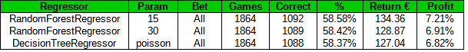
Conclusion
These results show that you can use Machine Learning models to help predict NBA scores.
Using the correct features and following specific patterns, this method does show a clear way to gain a profit from a simple decision of higher or lower.
This project is based on teams results over their previous 10 games. The analysis would be more complete if a variable was used to compare models using a different amount of games.

Slide 11
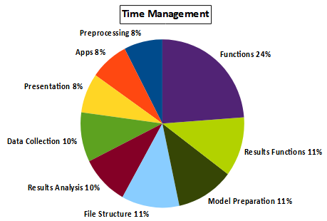
Thank you.
Any Questions?
Daniel Jonathan Walker
Data Science @ The Bridge | Digital Talent Accelerator
danielwalker1987.DW@gmail.com
https://www.linkedin.com/in/daniel-jonathan-walker-2a5a461b5/
https://github.com/danwalk/ML-Project-NBA-Predictor

